Slide 1
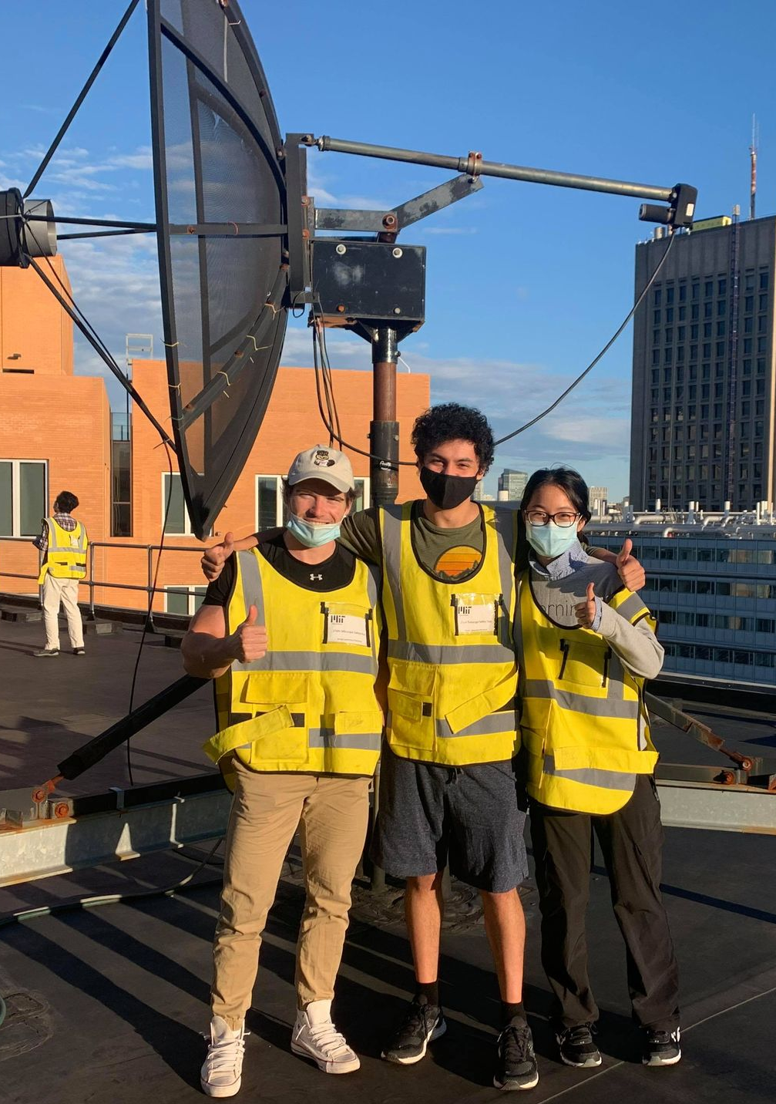
DarK Matter and the Rotation Curve of the Milky Way
Octavio Vega and Luke Gianni
8.13 Experimental Physics 1 – Fall 2021

Slide 2
Experimental Goals
Derive a Rotation Curve of the Milky Way
Compare experimental results with models
i.e. Classical models vs. newer models

Slide 3
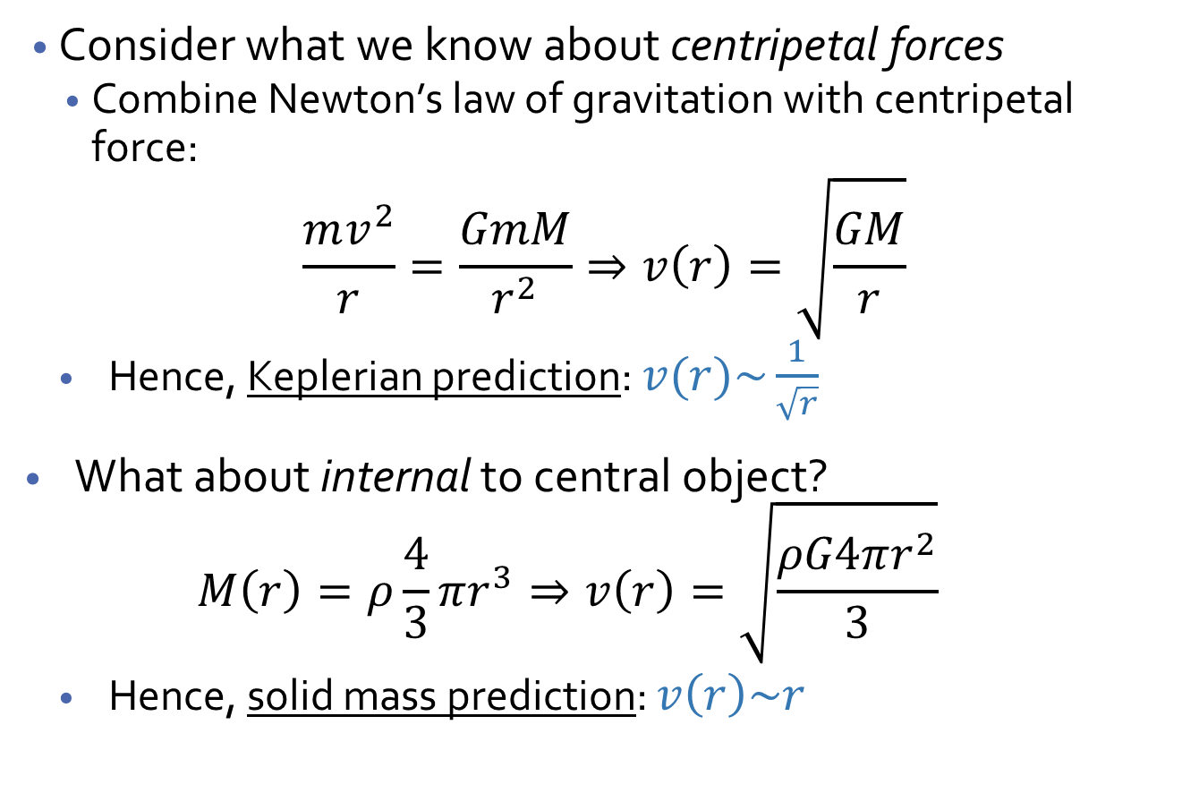
Theory of Gravitation and Rotation
Consider what we know about centripetal forces
Combine Newton’s law of gravitation with centripetal force:
$$\frac{mv^{2}}{r}=\frac{GmM}{r^{2}}⇒v\left(r\right)=\sqrt{\frac{GM}{r}}$$
Hence, Keplerian prediction: $v(r)\sim \frac{1}{\sqrt{r}}$
What about internal to central object?
$$M\left(r\right)=ρ\frac{4}{3}πr^{3}⇒v\left(r\right)=\sqrt{\frac{ρG4πr^{2}}{3}}$$
Hence, solid mass prediction: $v\left(r\right)\sim r$
m
r
M

Slide 4
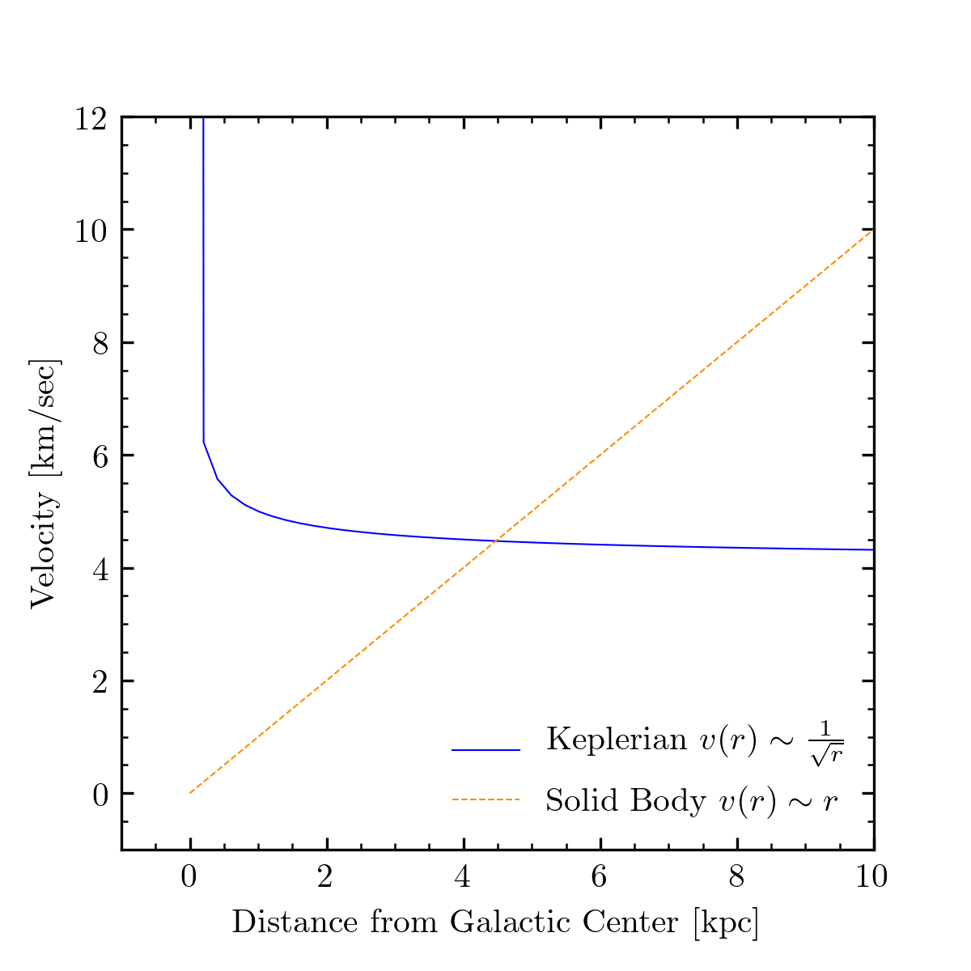
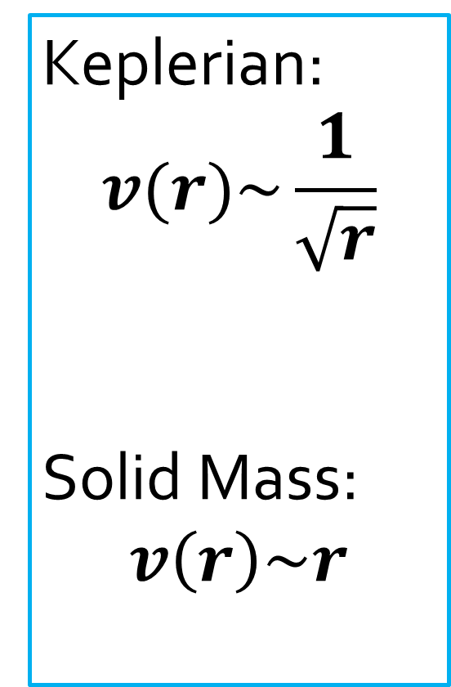
Theoretical Models of Rotation Curves
Keplerian:
$$v(r)\sim \frac{1}{\sqrt{r}}$$
Solid Mass:
$$v\left(r\right)\sim r$$

Slide 5
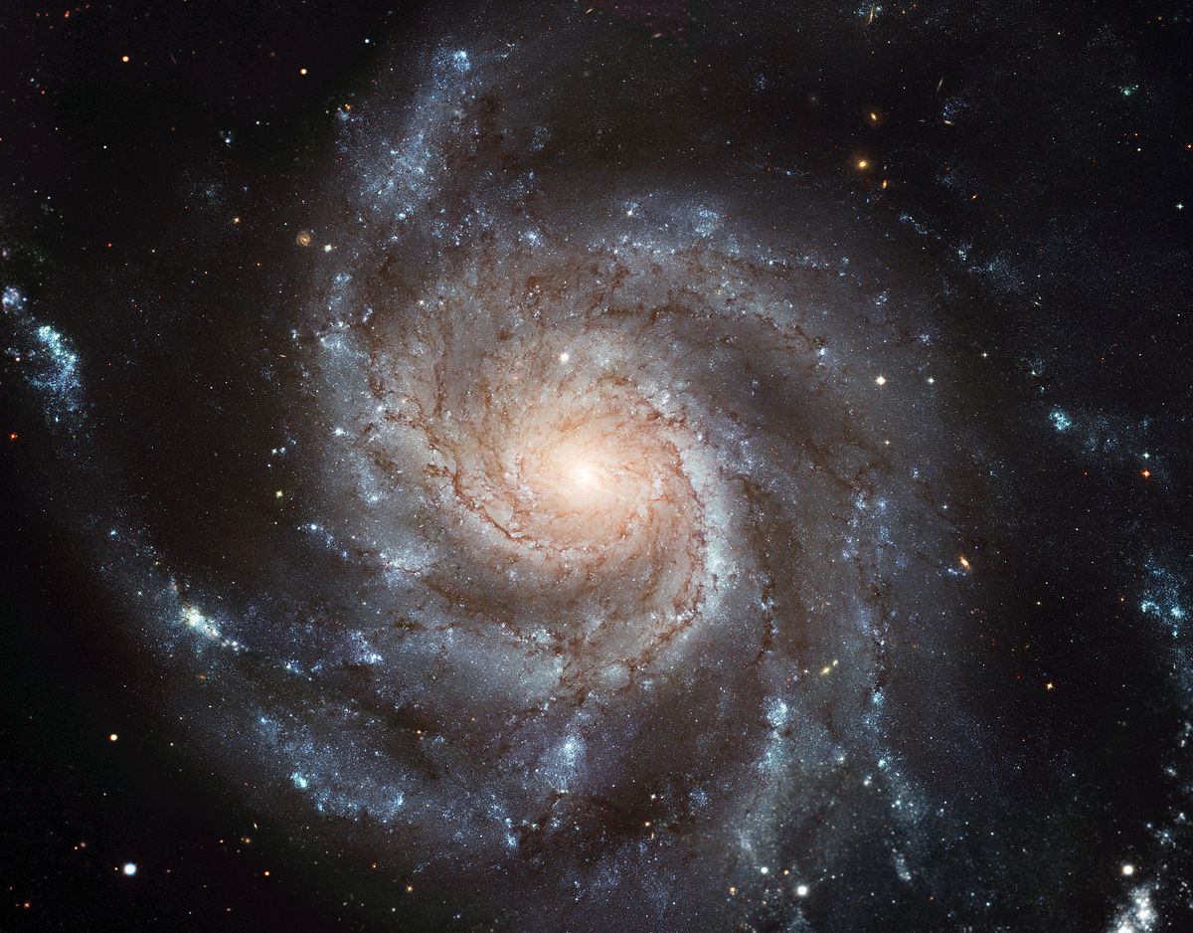

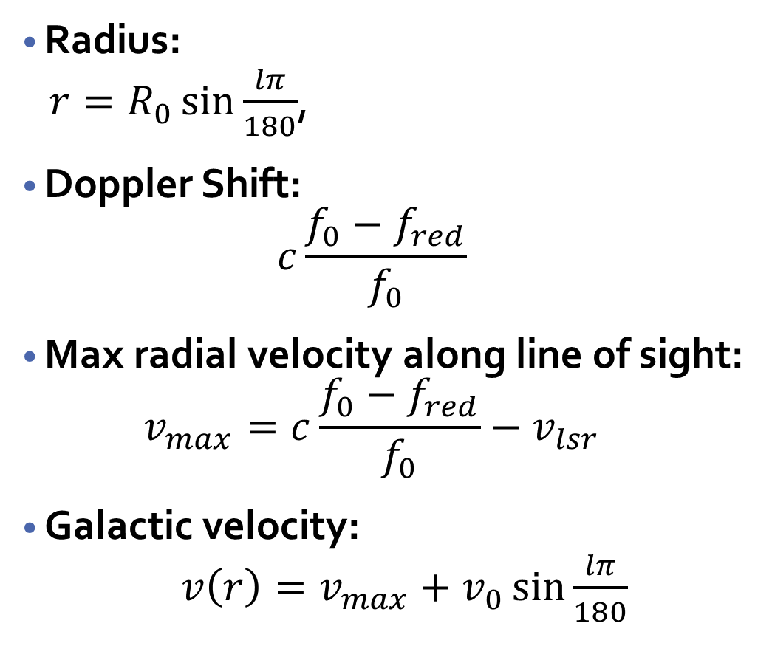



Computing Velocities – Geometry of the Galaxy
Radius:
$r=R_{0}\sin{\frac{lπ}{180}}$,
Doppler Shift:
$$c\frac{f_{0}−f_{red}}{f_{0}}$$
Max radial velocity along line of sight:
$$v_{max}=c\frac{f_{0}−f_{red}}{f_{0}}−v_{lsr}$$
Galactic velocity:
$v\left(r\right)=v_{max}+v_{0}\sin{\frac{lπ}{180}}$
$$v_{0}$$
$$R_{0}$$
$$r$$
$$l$$
Notes:
Vlsr = velocity of the local standard of rest, subtract this to factor out any revolution we have with respect to the sun

Slide 6
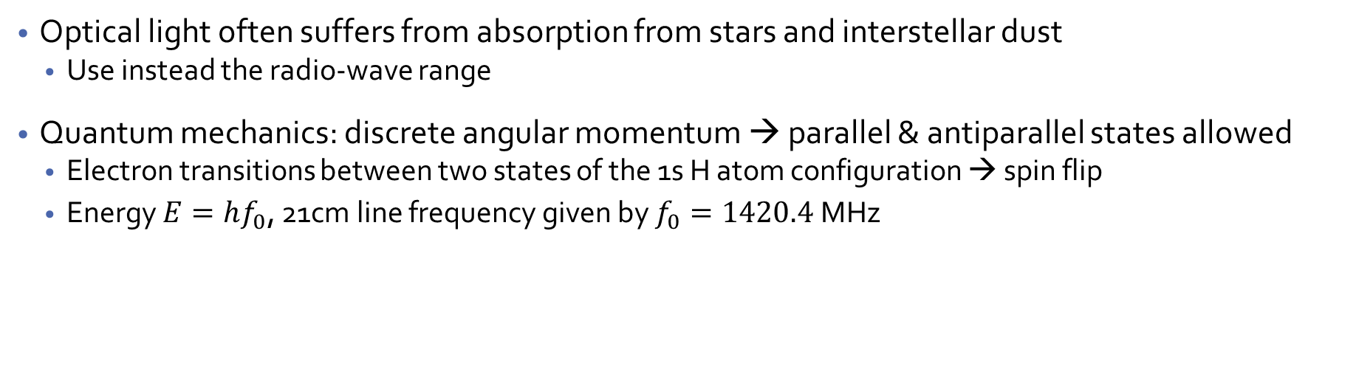
Theory of the 21cm Line of Hydrogen
Optical light often suffers from absorption from stars and interstellar dust
Use instead the radio-wave range
Quantum mechanics: discrete angular momentum → parallel & antiparallel states allowed
Electron transitions between two states of the 1s H atom configuration → spin flip
Energy $E=hf_{0}$, 21cm line frequency given by $f_{0}=1420.4$MHz

Slide 7
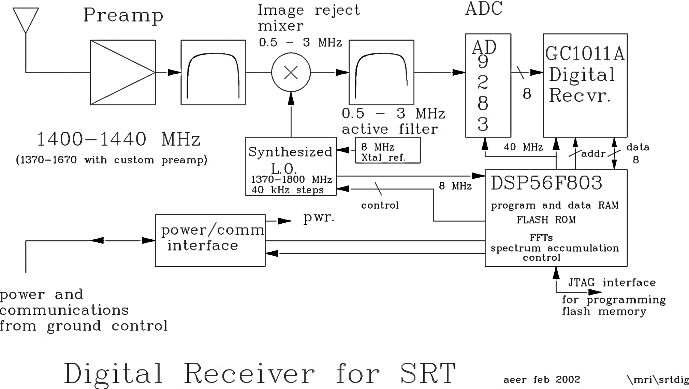
Small Radio Telescope (SRT) Signal Chain
Band Pass Filter
Keeps signal with difference of frequencies
Modulates signal

Slide 8
Data Collecting Scheme
1
2
3
Calibrate the Telescope
Point telescope at a galactic longitude
Average over 20 scans of region for Temperature spectrum
6
5
4
Repeat from 20 to 90 degrees in increments of 10
Fit a signal to results to calculate max red-shift frequency
Fit background model to each spectrum and remove
7
8
9
Calculate velocities and distances from these data
Derive an experimental rotation curve of Milky Way
Compare fits to the two velocity models

Slide 9
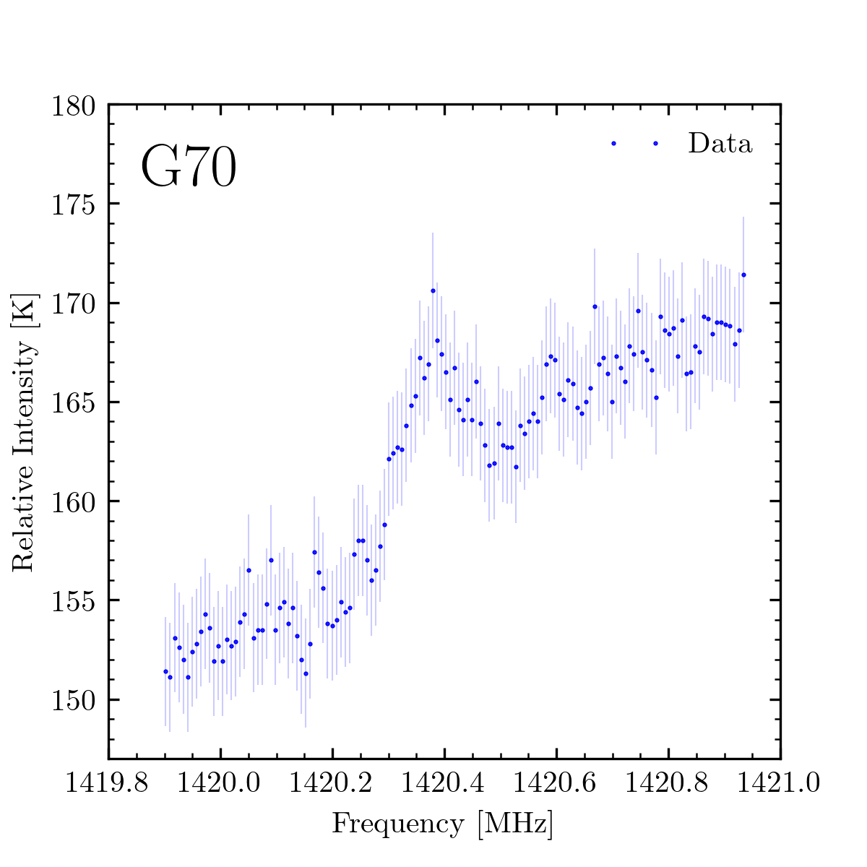
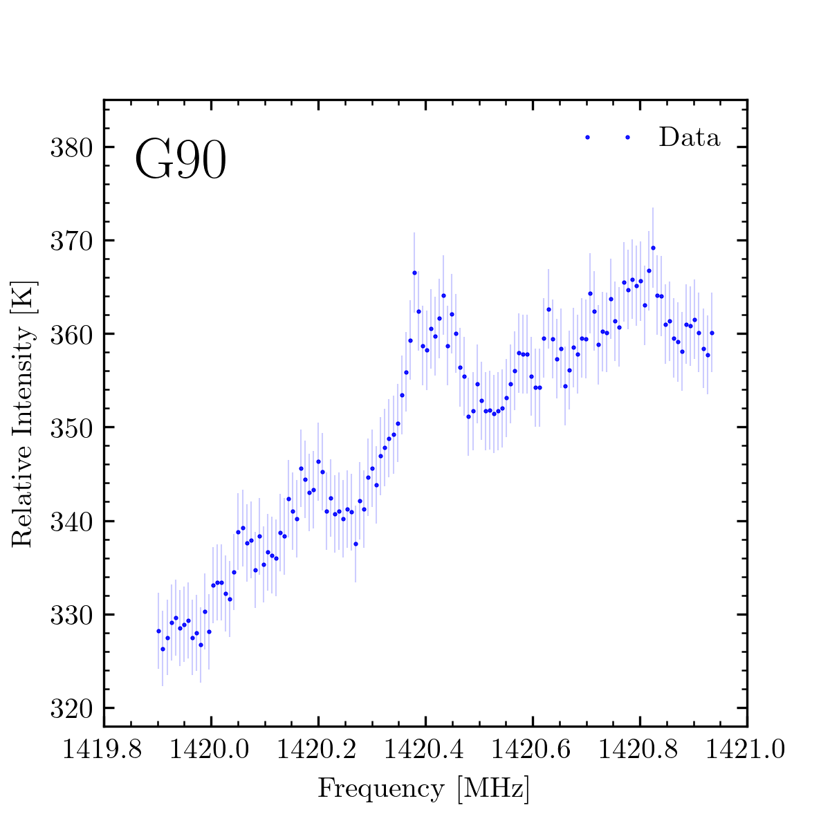
Raw Intensity Spectra in Frequency Bins

Slide 10
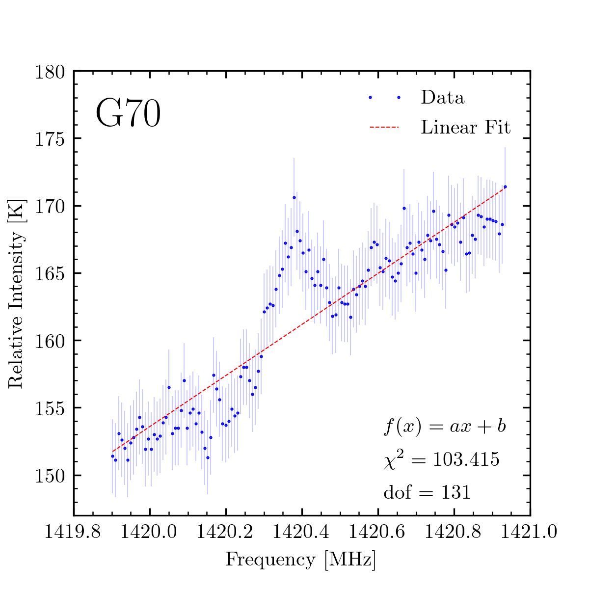
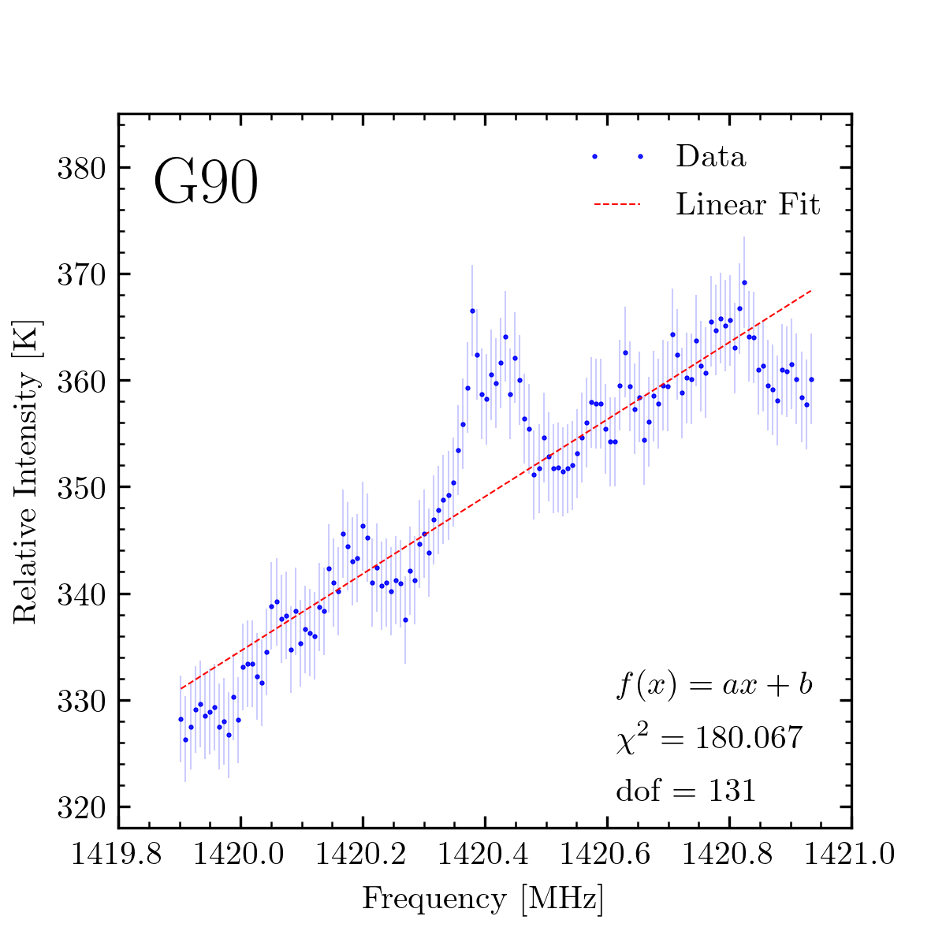
Fitting to the Background
Notes:
I use linear background because the calibration curves I saw had greater signal amplitude than the signals in the galactic plane

Slide 11
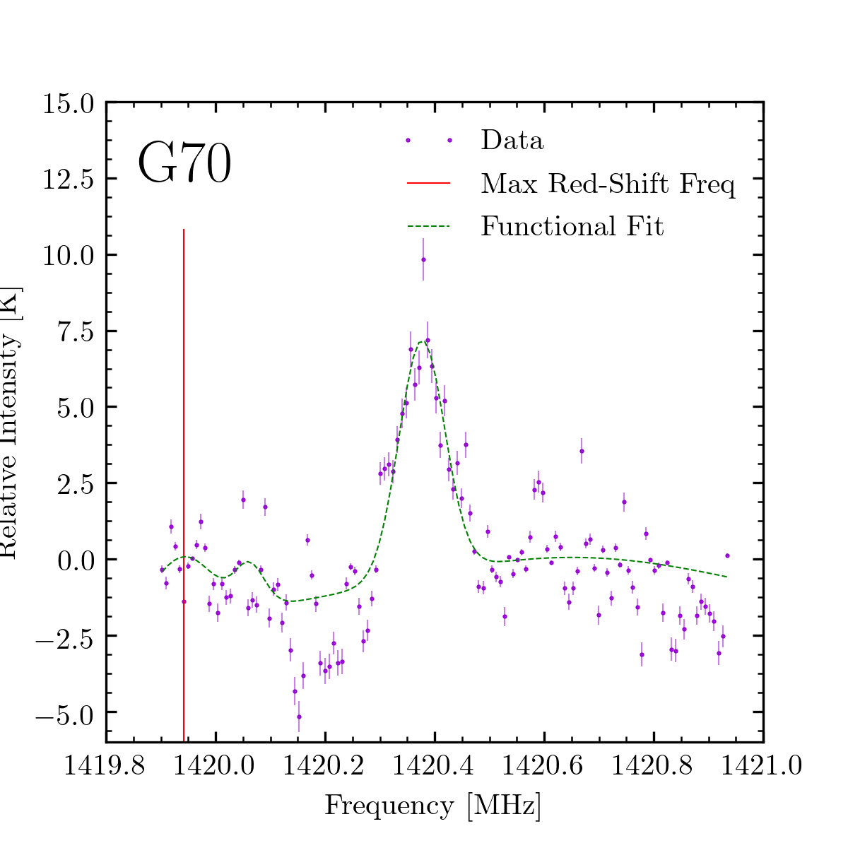
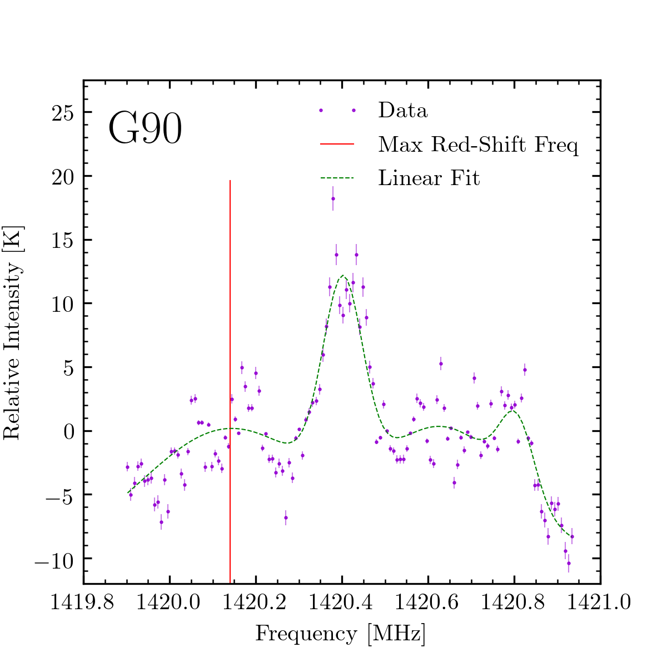
Background-Subtracted Fits to the Red Shift

Slide 12
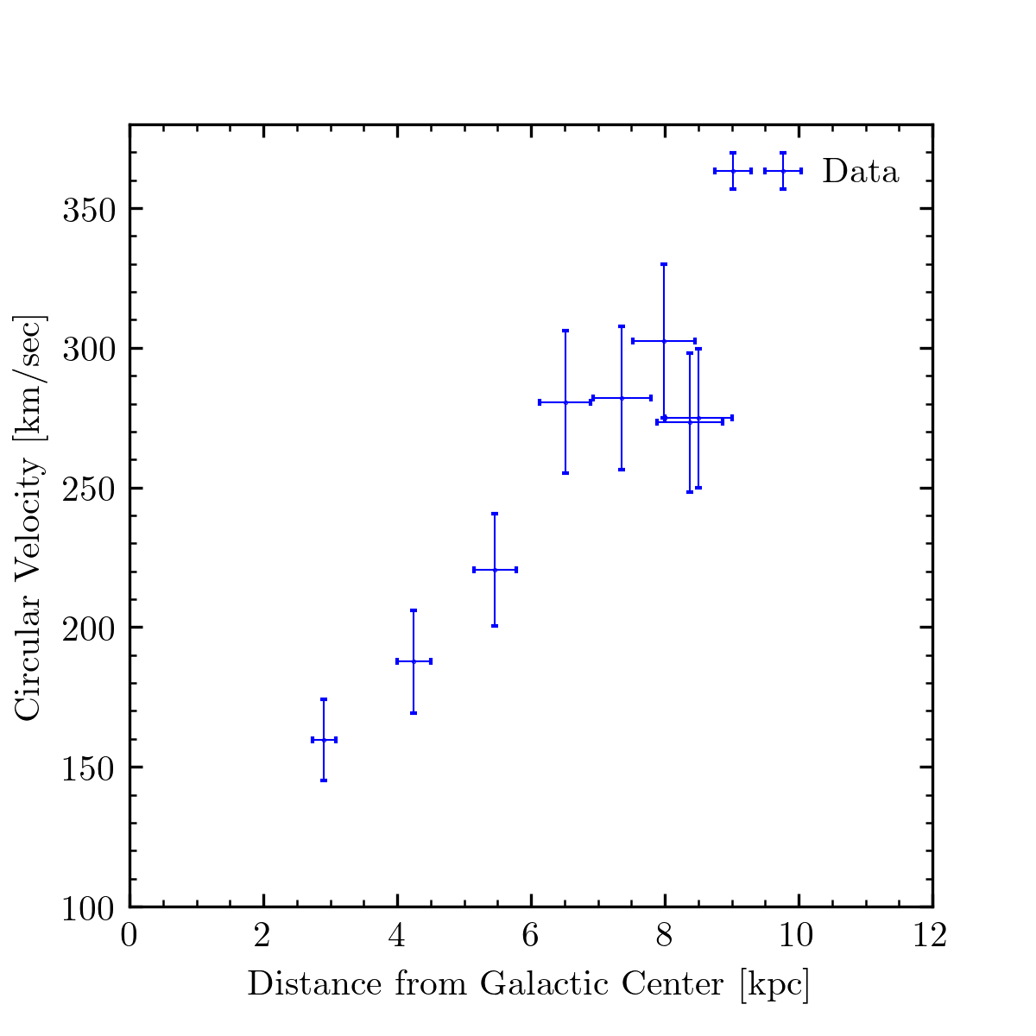
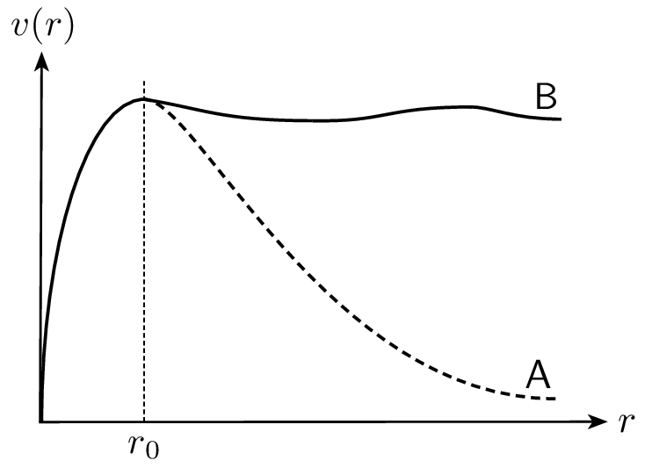
Comparing Our Rotation Curve with Other Observations
Notes:
Image source: https://www.researchgate.net/figure/A-typical-galaxy-rotation-curve_fig1_317713702

Slide 13
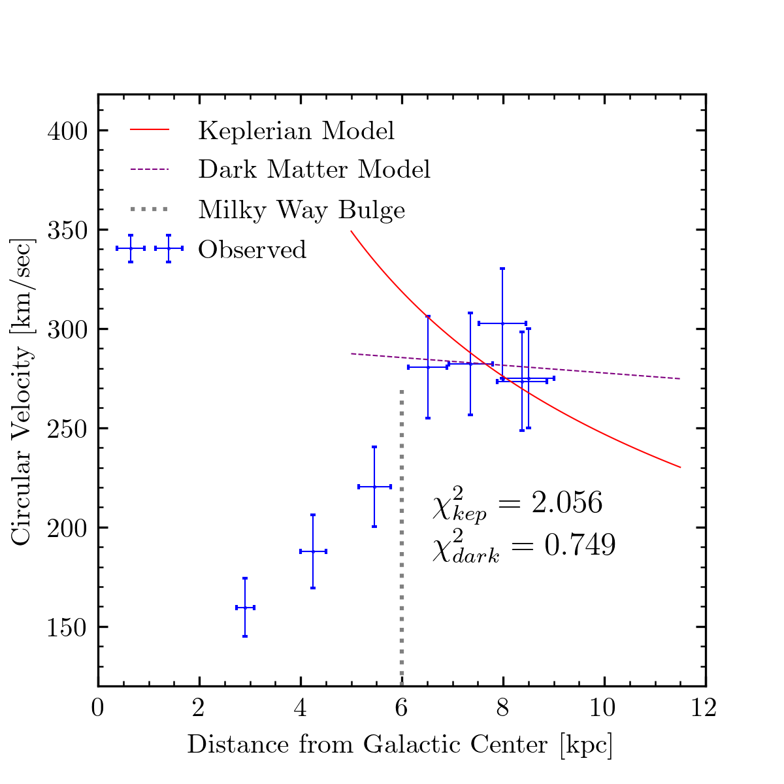
Fitting Velocity Data to Two Models of Rotation
Notes:
Statistical errors that I will describe later

Slide 14
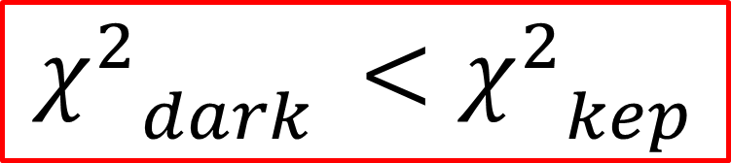
Comparing Rotation Curve Model Fits
$${χ^{2}}_{dark }<{χ^{2}}_{kep}$$

Slide 15
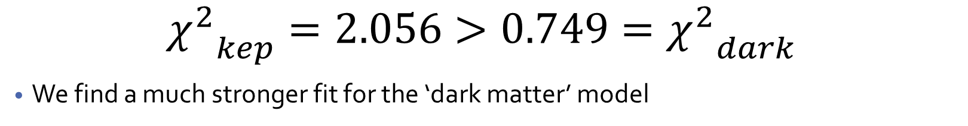
Results and Discussion of Errors
$${χ^{2}}_{kep}=2.056>{{0.749=χ}^{2}}_{dark}$$
We find a much stronger fit for the ‘dark matter’ model
Statistical
Systematic
Much fewer longitudes on lower end of galactic coordinates scanned than desired
Fewer sessions of data gathering than desired
Connection to SRT occasionally lost during CMD file readings
Some low-longitude scans performed on longitudes that were partially/becoming invisible due to out of bonds of telescope view
Fit function for red-shift frequency not precisely determined; only by inspection
2 days of data taken during high cloud cover, heavy rain

Slide 16
Summary, Conclusion, and Future Steps
What have we accomplished?
Derived an experimental velocity curve for the milky way
Explored its relationship to other models of rotational velocity
Confirmed that a ‘dark matter’ model fits the results better
What could we improve?
Longer integration time per trial
More scans within the same regions
More rigorously time scans with visible regions
Where can these results lead?
Probing the true mass density of potential dark matter
Constructing the spiral-arm structure of the milky way

Slide 17

Appendix A: Functional Form for Fitting
$$f\left(x\right)=a_{1}e^{\frac{{−(x−μ_{1}^{})}^{2}}{2{σ_{1}}^{2}}}+a_{2}e^{\frac{{−(x−μ_{2}^{})}^{2}}{2{σ_{2}}^{2}}}+a_{3}e^{\frac{{−(x−μ_{3}^{})}^{2}}{2{σ_{3}}^{2}}}+a_{4}e^{\frac{{−(x−μ_{4}^{})}^{2}}{2{σ_{4}}^{2}}}+b$$

Slide 18
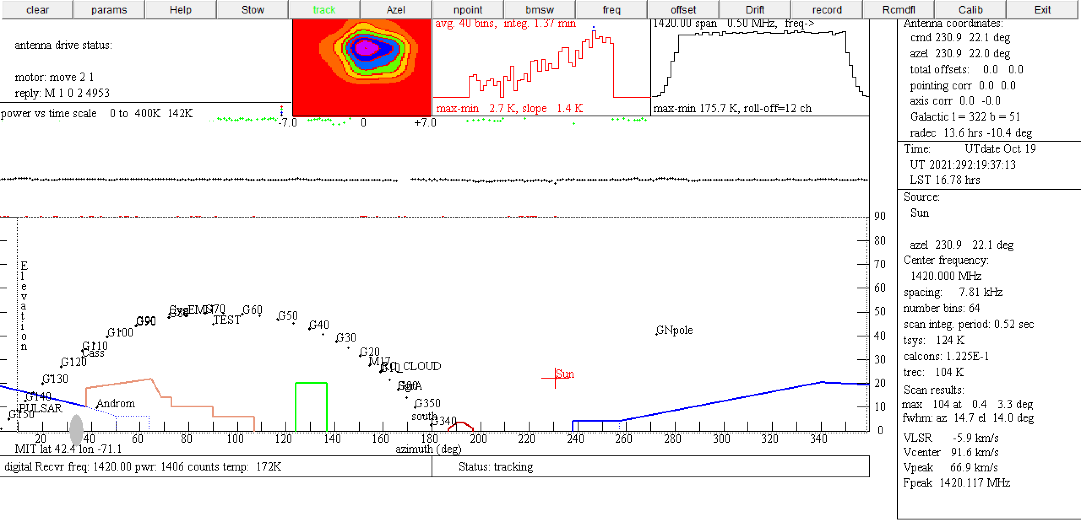
Appendix B: Telescope and Experimental Procedure
Calibration Region
vLSR
Galactic longitudes
Azimuthal axis
Elevation axis

